Slide 1
Networking - Basics

Slide 2
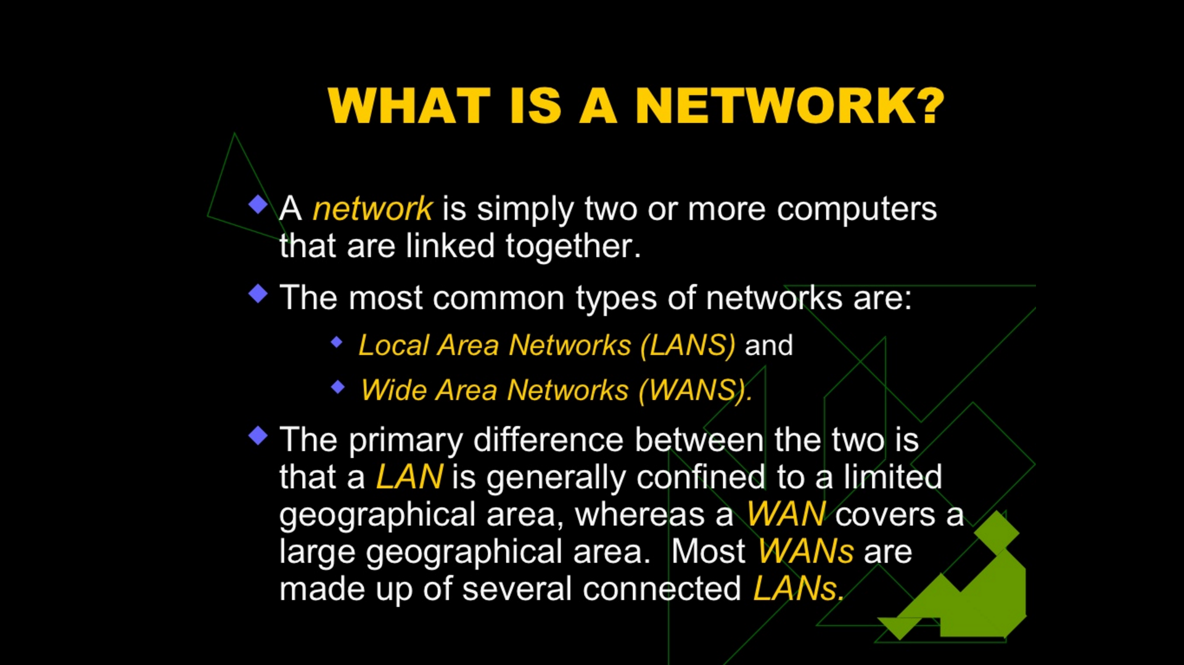
Add your first bullet point here
Add your second bullet point here
Add your third bullet point here

Slide 3
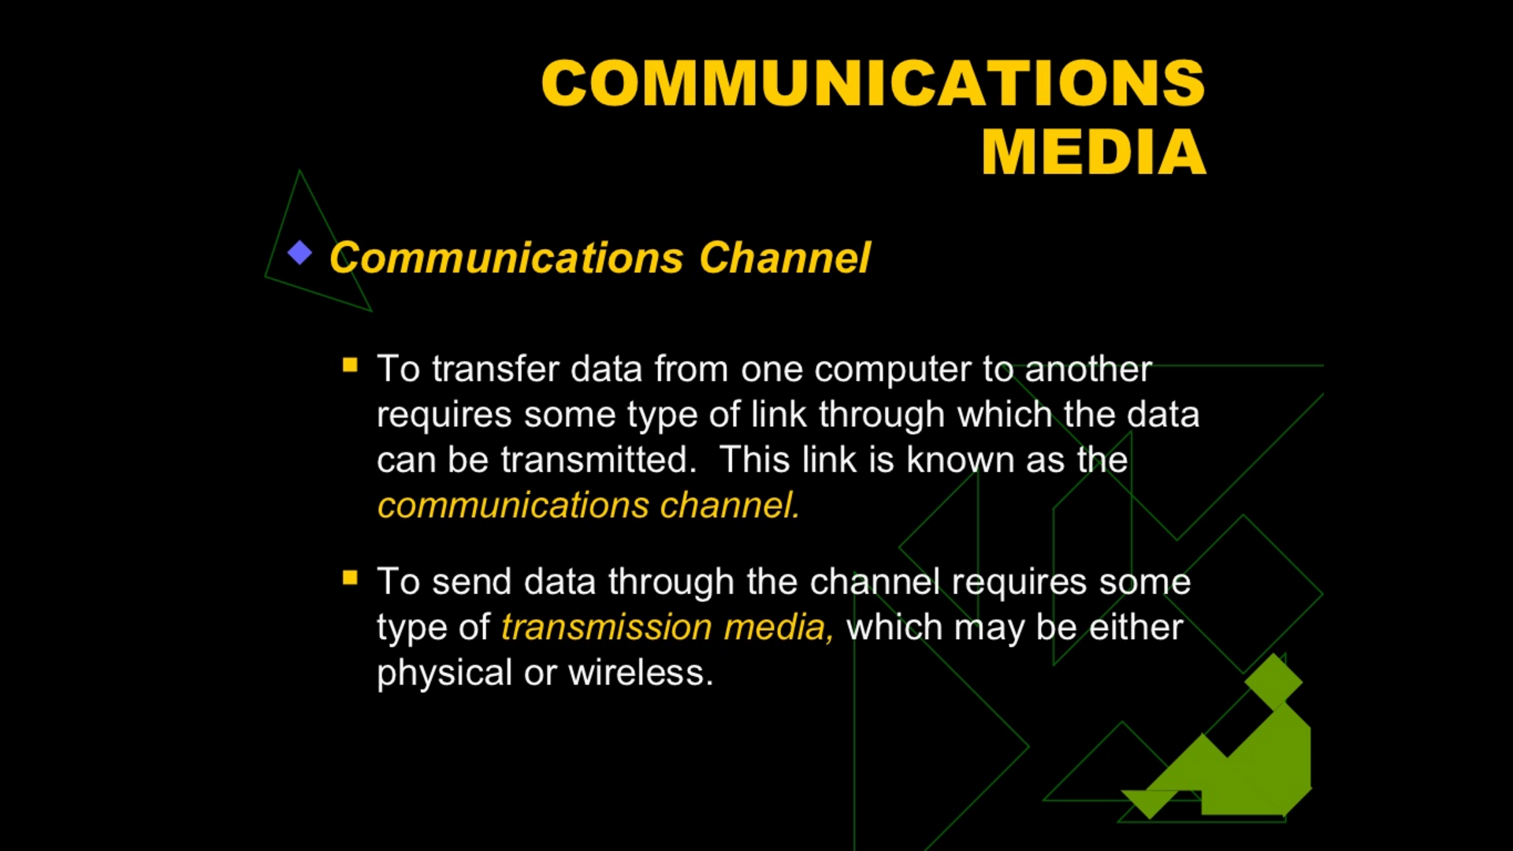

Slide 4
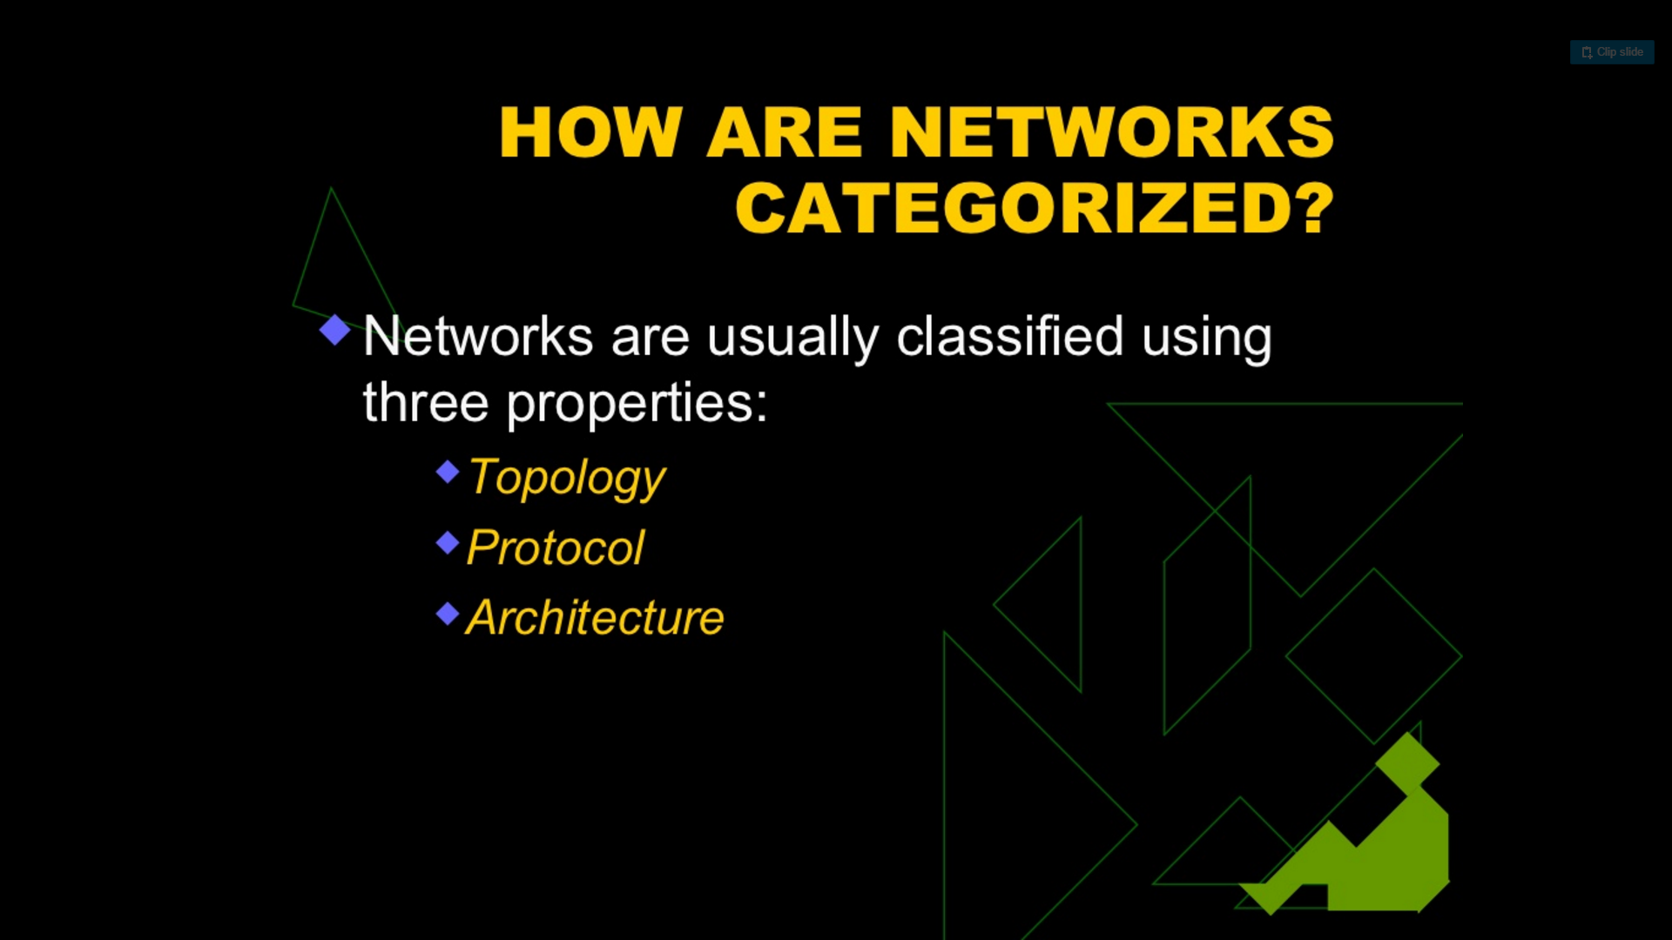

Slide 5
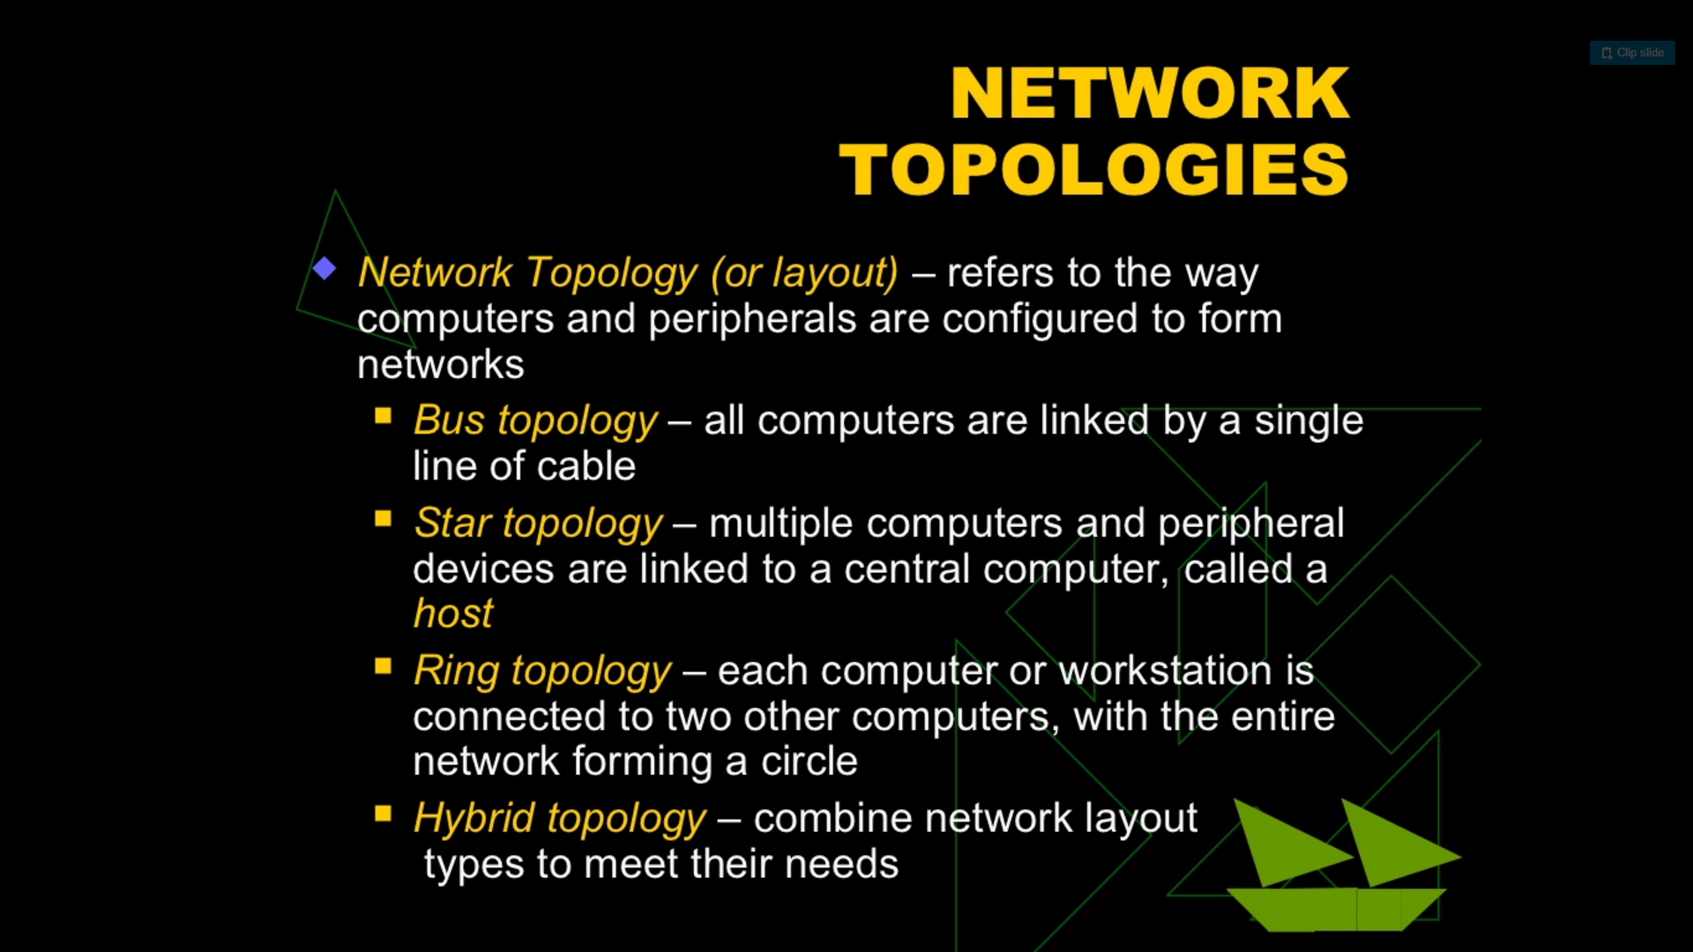

Slide 6
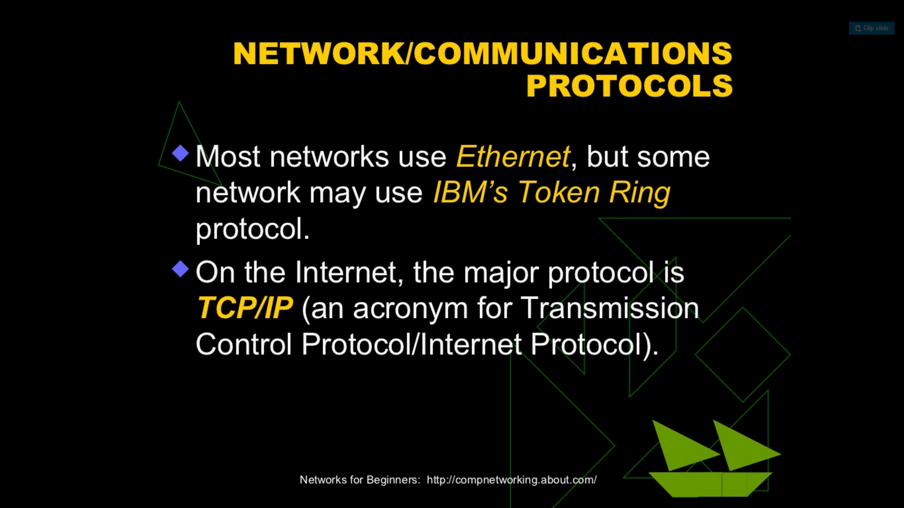

Slide 7
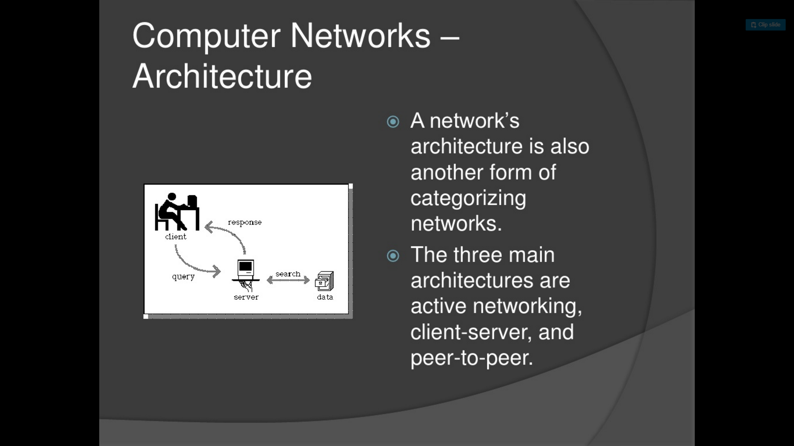
Add a Slide Title - 3

Slide 8
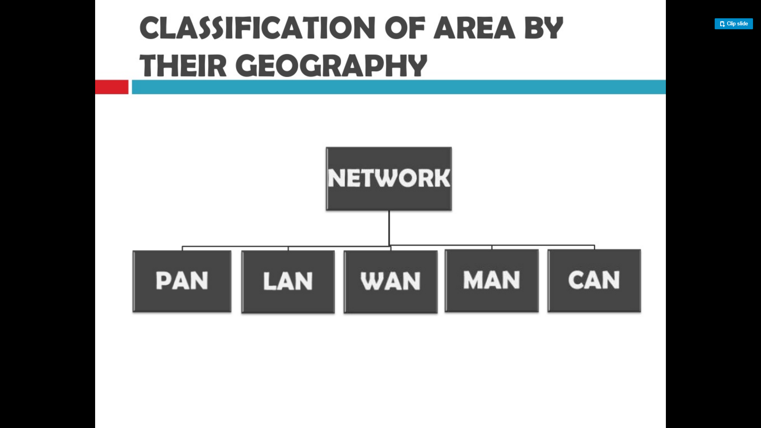

Slide 9
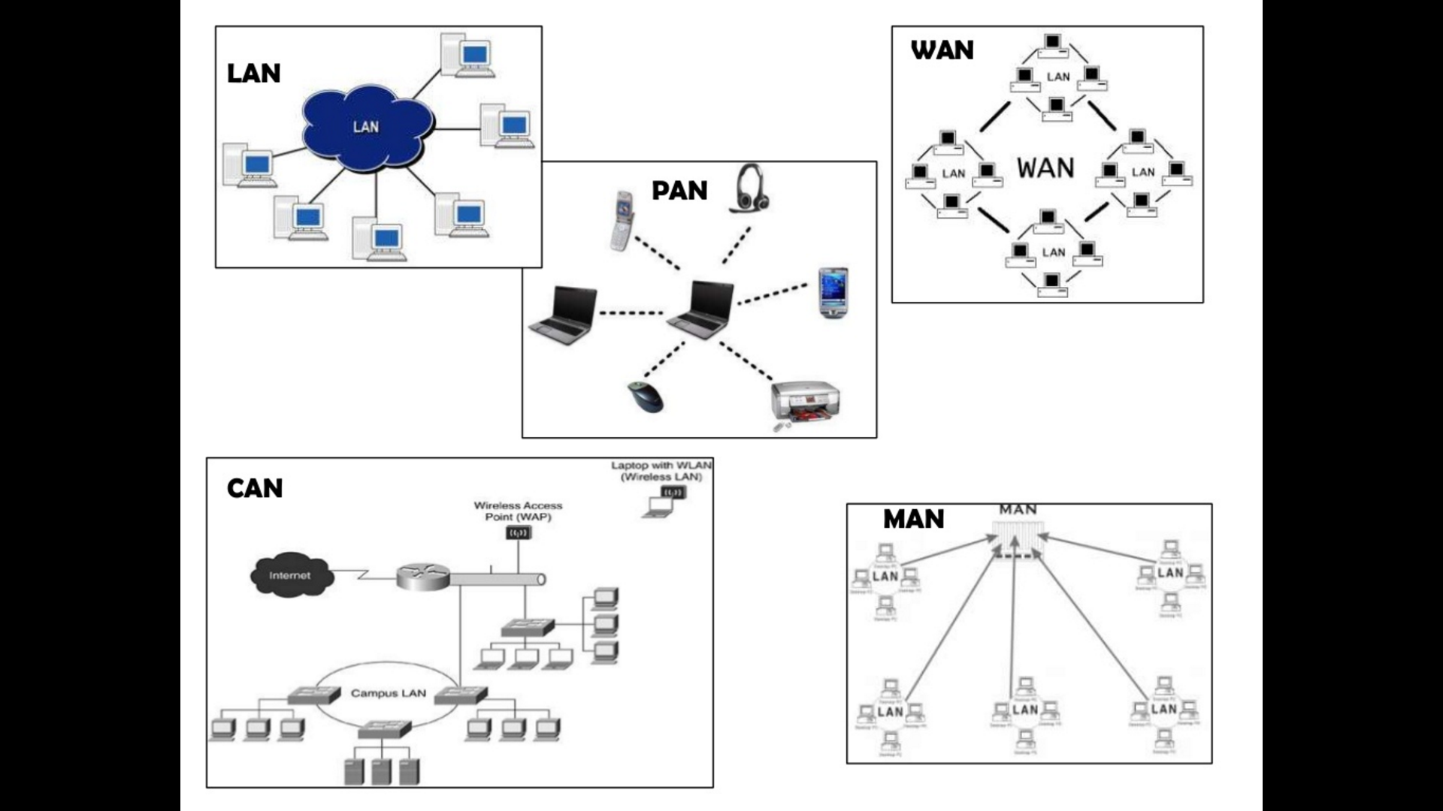

Slide 10
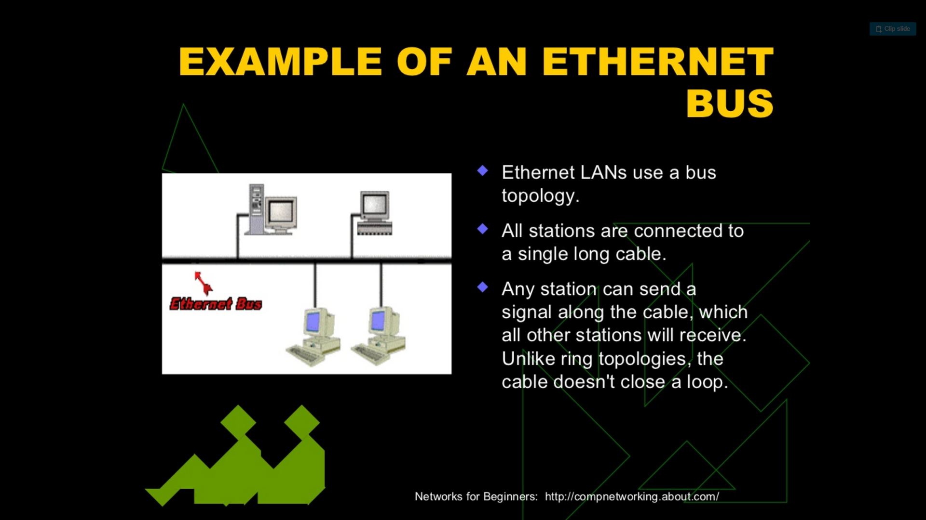

Slide 11
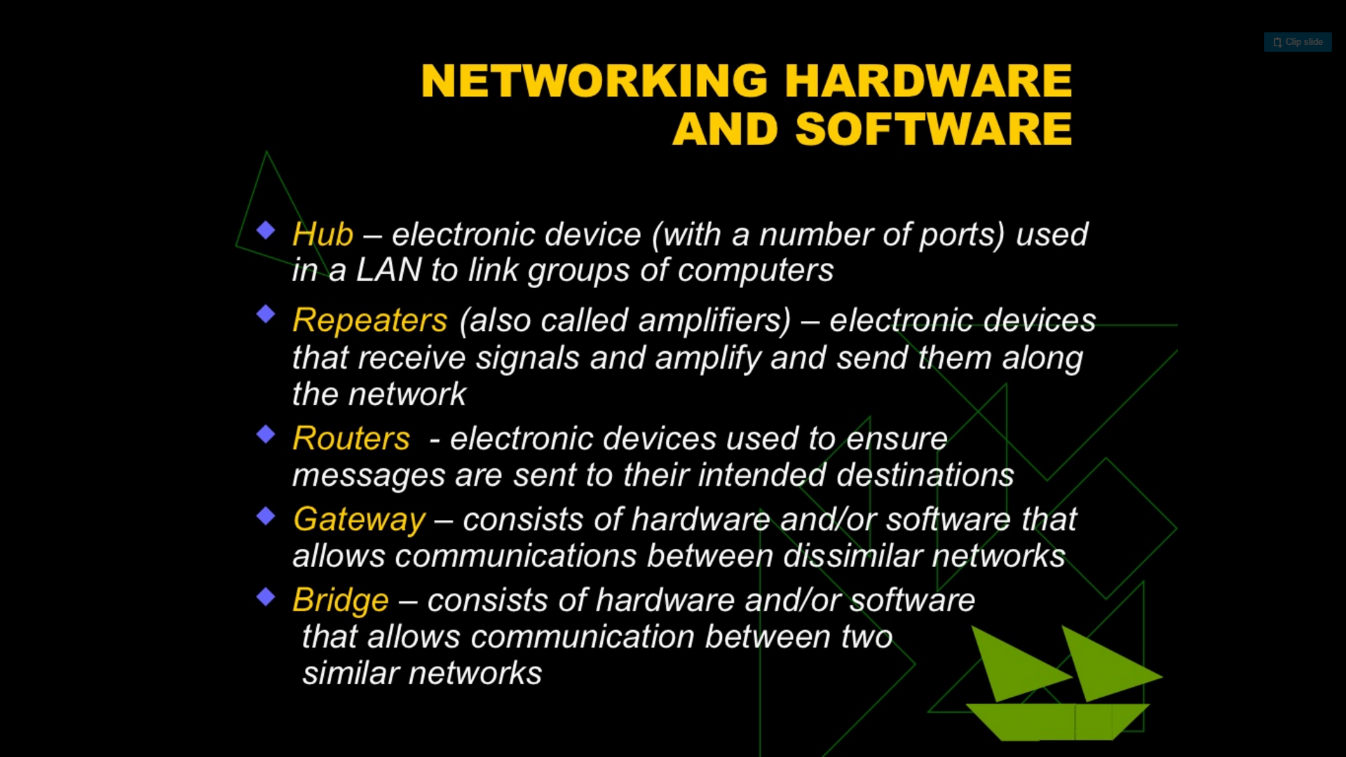

Slide 12
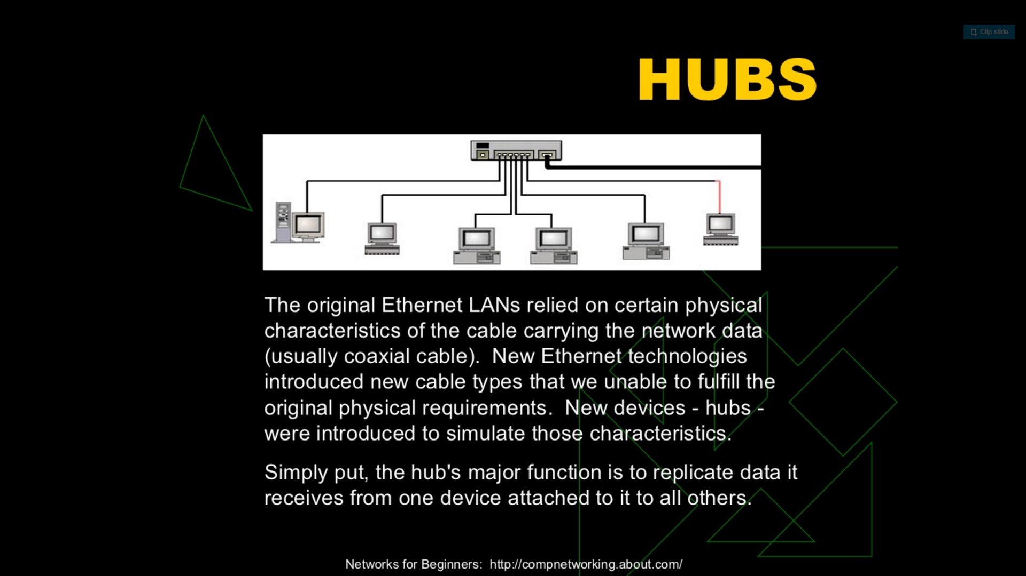

Slide 13
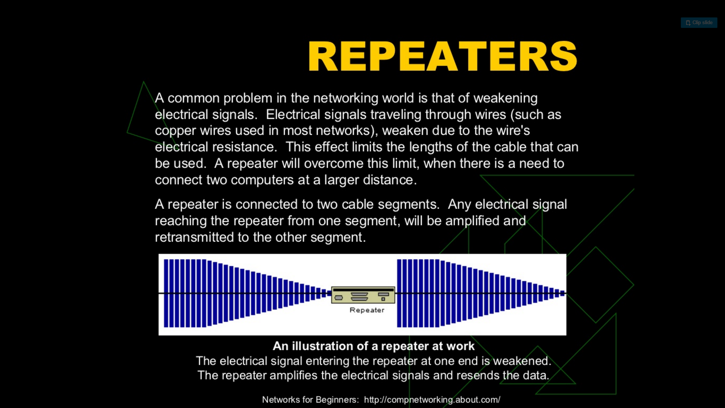

Slide 14
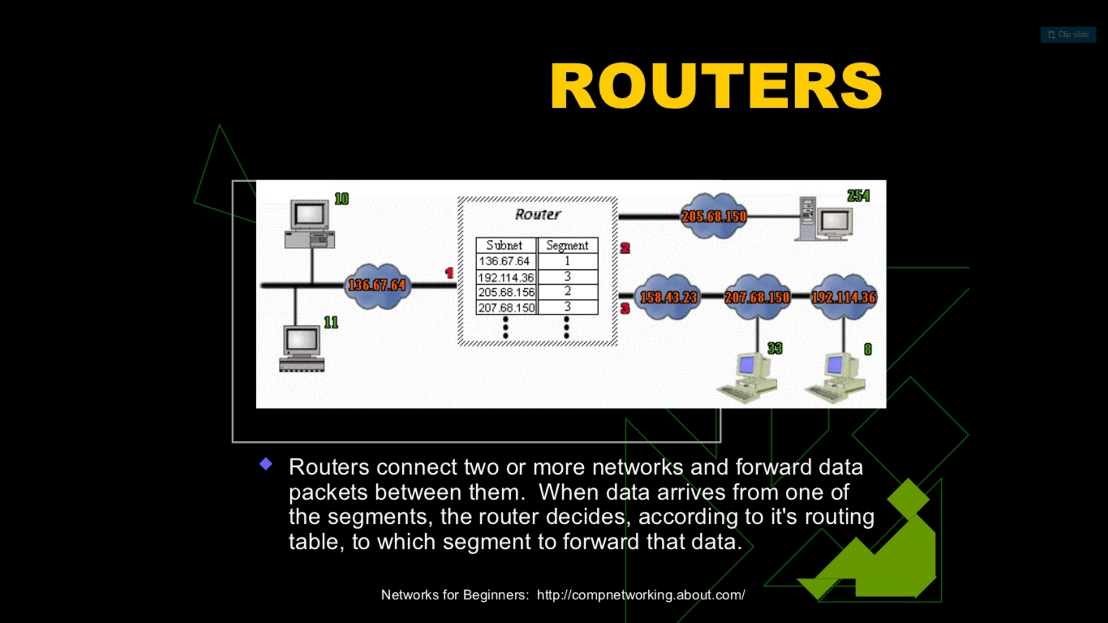

Slide 15
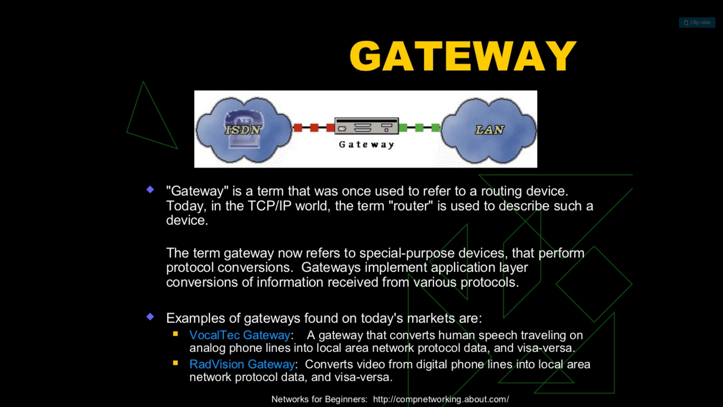

Slide 16
ASSIGNMENT - 1
Read…
https://en.wikiversity.org/wiki/Introduction_to_Computers/Networks
What do you understand by physical and logical topology of a network ?
Explain which physical and logical topologies do these below networks belong to …..
Twisted pair Ethernet
IBM’s Token Ring

